Slide 1
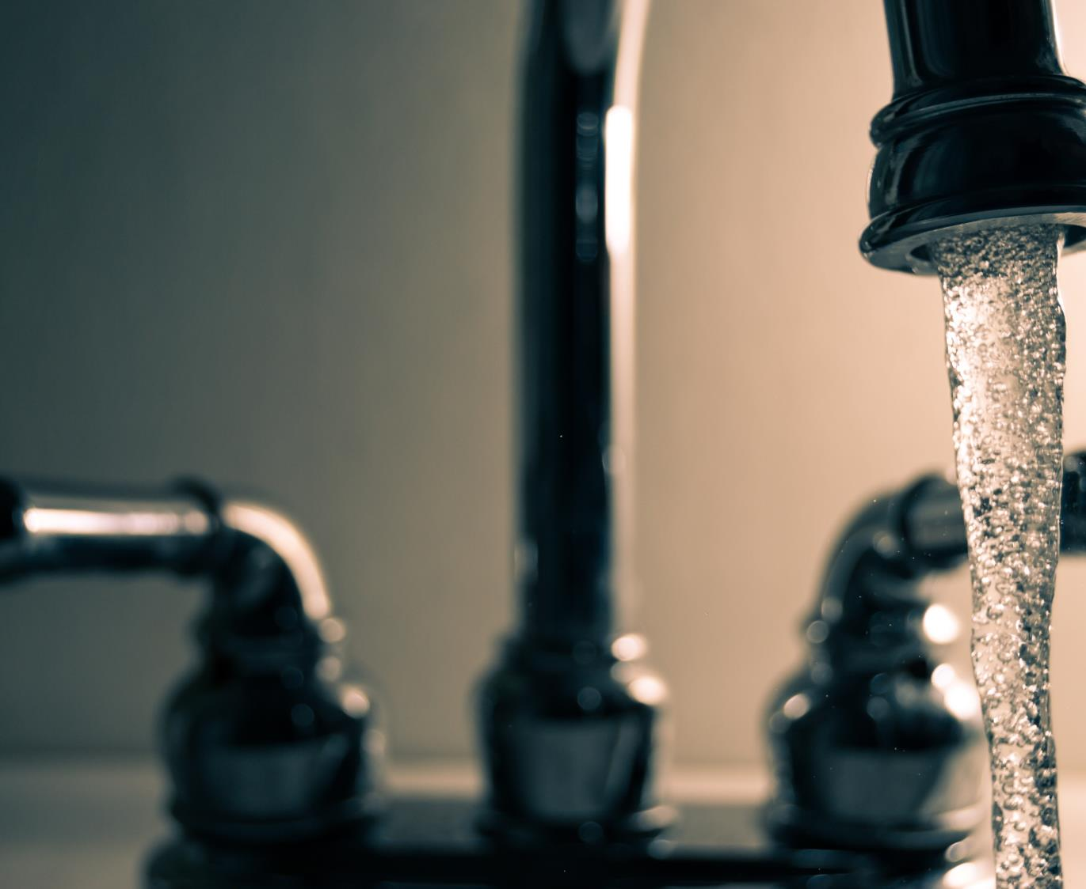
City of Abilene
Water Rate Study
December 2025

Slide 2

Agenda
Rate Study Process
Background
Financial Plan
Cost of Service and Rates

Slide 3




Rate Study Overview
Financial Plan
How much total revenue is needed?
Cost of Service Study
What is each class’s share of costs?
Rate and Fee Design
What rate and fee structure best align with the City’s values?
3

Slide 4
Current Status of the Water Utility
Existing Rate Structure
$18.77 monthly fixed charge, plus $4.47 per 1,000 gallons of water used.
Large commercial customers pay a lower rate on water above 225,000 gallons per month.
Current fund balance is effectively $0
Recent deficit spending has depleted water fund reserves.
Minimal financial planning for long term capital needs.

Slide 5
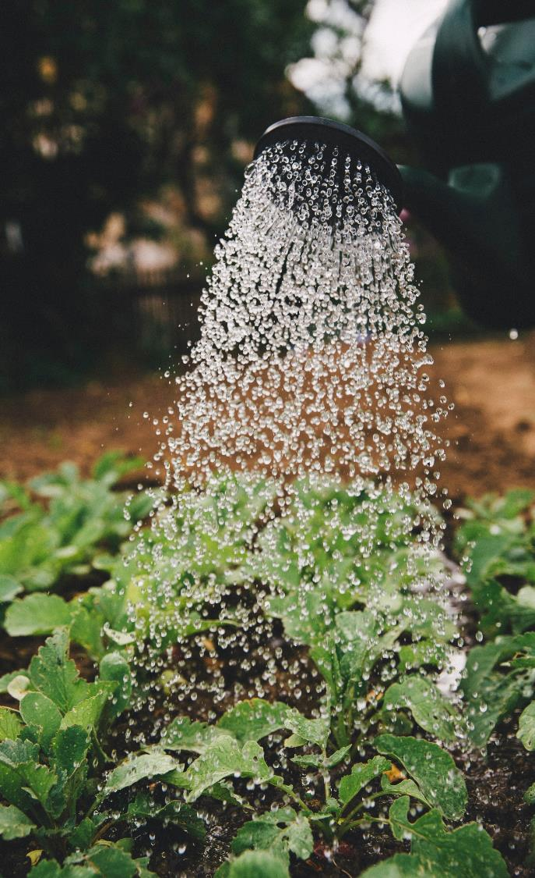
Financial Planning
1
Forecast Baseline Revenue
2
Forecast Operating and Capital Expenditures
3
Develop Cash Flow Forecast and Revenue Sufficiency

Slide 6
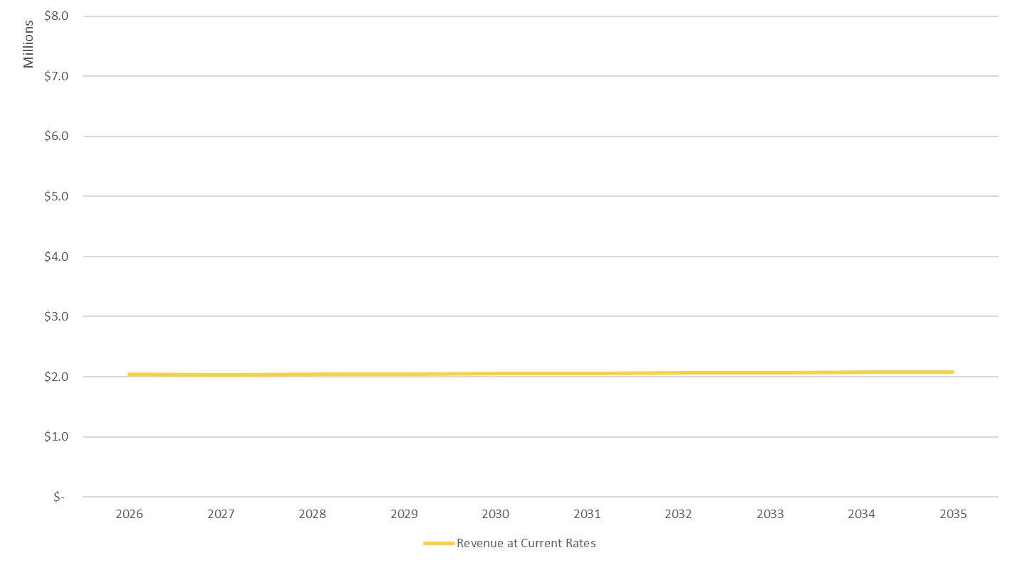
Step 1: Baseline Revenue
Revenue projections under existing rates.
Approximately $2 million per year.
6

Slide 7
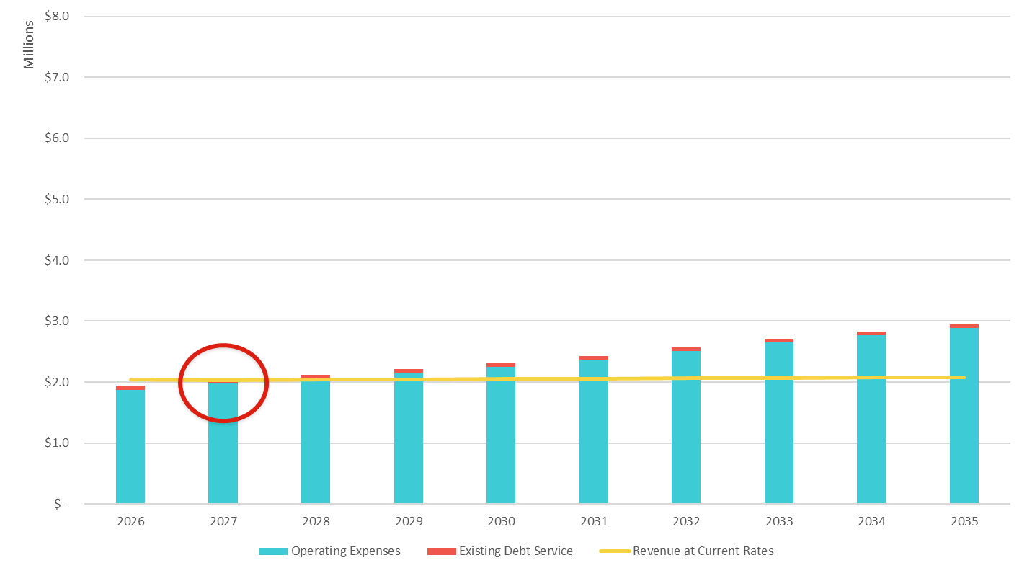
Step 2: Operating Expenses and Existing Debt
Adopted 2026 budget serves as the baseline of the forecast.
4% cost inflation
General Fund transfer updated to 5% of rate revenues.
Series 2019 GO Bond

Slide 8
Step 2: Capital Planning
Water Main Replacement Program
$400 to $500 thousand in recent years
Annual needs could be over $2 million
Plan calls for increasing to $1 million by 2030
Miscellaneous Needs
PLC replacements, membrane replacements, generators, vehicles, etc.
Total of $1.5 million through 2030
Water Tower Replacements
Estimated cost of $15 million each
Precise timeline is currently unknown, first replacement potentially in 2031
Not funded in proposed 5-year rate plan
Expected to be debt financed
8

Slide 9
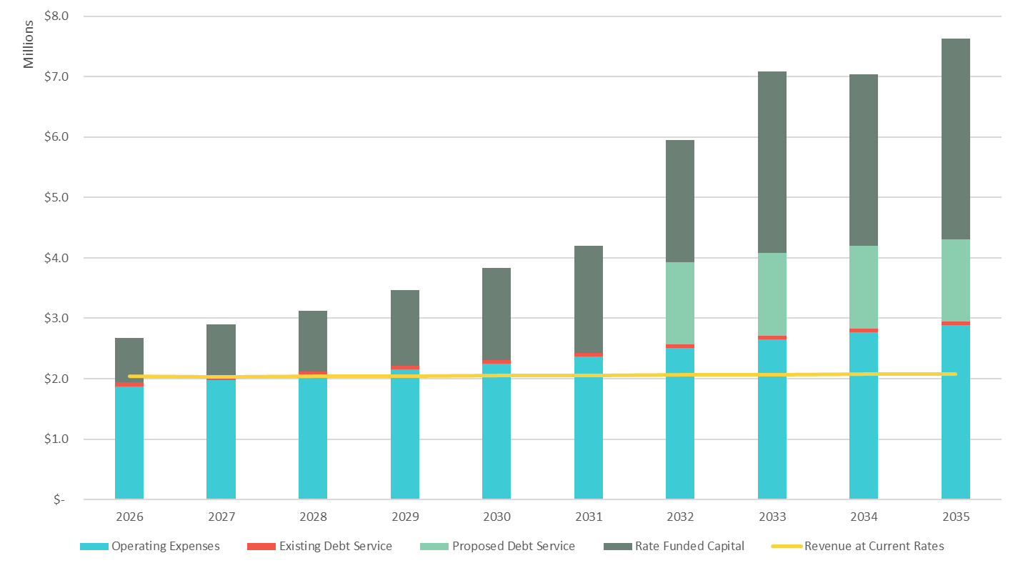
Step 2: Capital Costs
Without rate increases, revenue is not sufficient to continue any capital program.

Slide 10
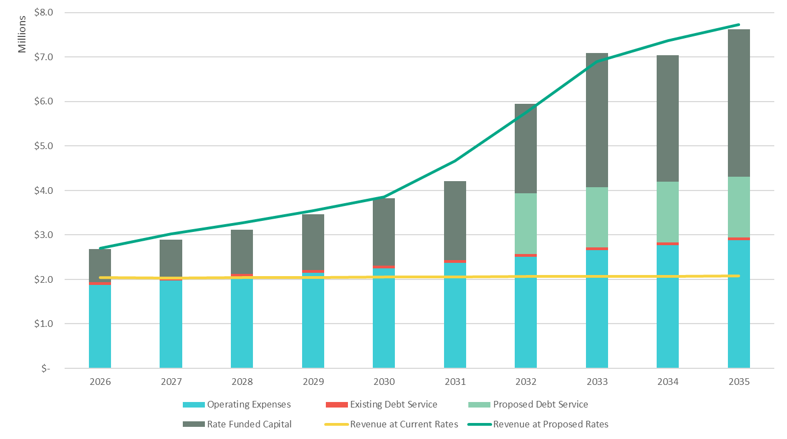
Step 3: Financial Plan Cash Flow Forecast – Sufficiency
Raftelis recommends a 45% rate increase in March 2026, followed by 9% increases each year through 2030.
The City should expect additional significant rate increases to replace each water tower.

Slide 11
How do we set rates under Cost- -of-Service principles?
How Much Money?
Determine revenue requirement (Costs)
Functionalize
Supply and Treatment, Transmission, Distribution, Customer Service, Meters and Services, Administration
Cost Components
Average Day, Maximum Day, Maximum Hour, Accounts, Equivalent Meters
Distribute to Classes
Residential, Commercial, Irrigation, RWD #2
Design Rates
Fixed System Charge by Meter Size, Volume Rates

Slide 12
Proposed Rates
Raftelis recommends four rate structure adjustments:
Adopt a fixed charge that varies by meter size. Customers with larger meters will pay more.
Implement an inclining block rate structure for residential customers.
Up to 4,000 gallons – essential indoor use
4,001 to 10,000 gallons – responsible outdoor use
Above 10,000 gallons – excessive outdoor use

Slide 13
Proposed Rates
Replace the commercial declining block structure with a uniform rate.
Introduce an irrigation rate set equal to the second residential tier.

Slide 14
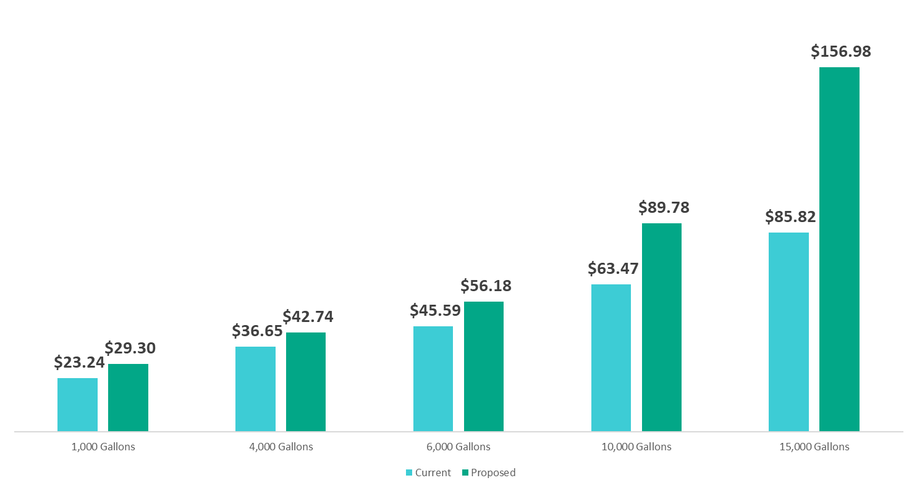
Customer Bill Impacts

Slide 15
Current Water Bill Affordability
0.91%
Median Household
The average bill for 4,000 gallons per month requires 0.91% of the Median Household Income in Abilene.
A common guideline suggests that a water bill should not be more than 2% of income.
1.88%
Lowest Quintile
The same bill requires 1.88% of income for households with income at the 20th percentile in Abilene.

Slide 16
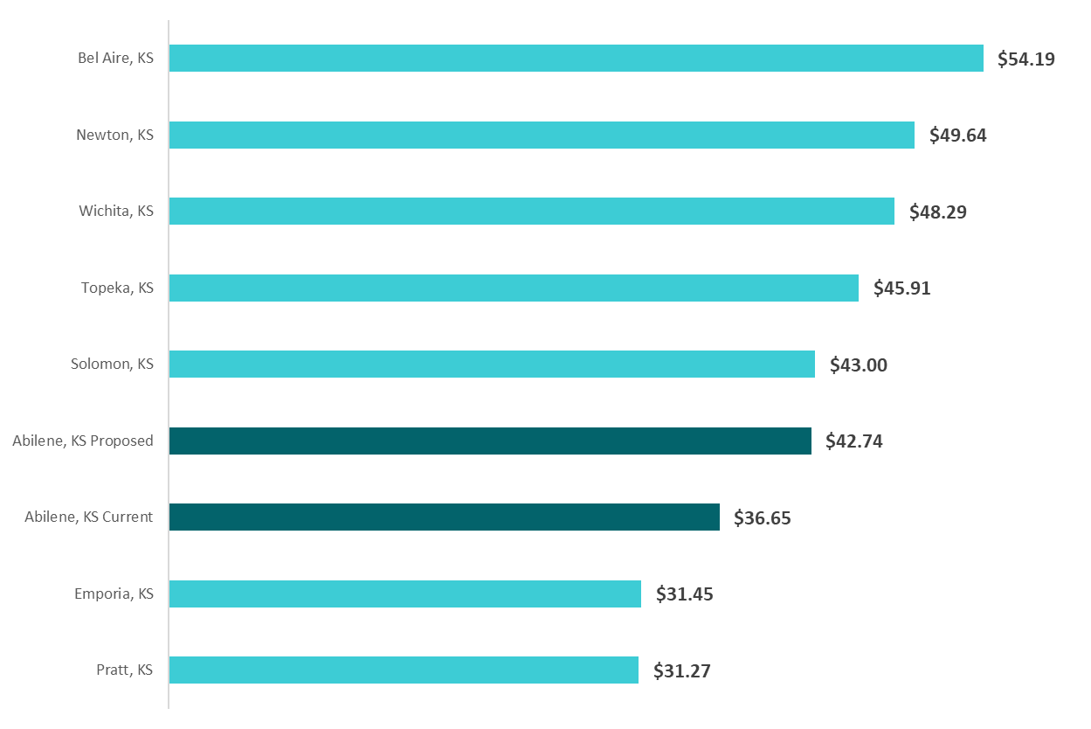
Comparison to Other Communities 4,000 Gallons Monthly
Even after the proposed rate increases, Abilene compares favorably.

